Slide 1


Platform for Improving Searchability and Interactivity of Recorded Lectures
Group 19-087
Notes:
Good afternoon dear …
We are group 19-087 and our submission is...
First let me introduce our group members...

Slide 2
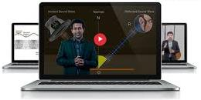
Recorded Lectures
Many Universities provide the facility to view pre-recorded lectures online
Benefits
Allows teachers to save hours of repetitive teaching.
Re-watch Complicated lectures
Students can learn at their own pace
However…
Notes:
I would like to start by explaining the motivation behind creating this product
Recorded Lecture videos -> mainstream -> because they have a host of benefits as u can see in the slide
* Rewatch complex/ complicated lectures
* Non-Native english speakers : Rewatch at own pace
* Rewatch at own pace to take notes
* Distance learning students -> Students who cannot be in class physically will not miss the lecture
* Revision

Slide 3

Research Problem
When viewing online lecture videos students come across a few problems.
Video lectures are usually lengthy and tedious to watch.
Poor searchability through the video
Less interaction with the student
Not directly connected to other supporting material such as Lecture slides and Tutorials
Many of the existing tools to improve lecture quality require human intervention which is time consuming
Notes:
I admit that There are softwares that allow you to improve lectures manually but,
If you put yourself in the shoes of a lecturer/content creator -> you'd find that modifying each lecture video by hand is tedious and time consuming
Which brings us to our proposed solution

Slide 4







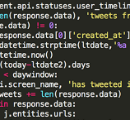
Proposed Solution
Notes:
A web app _> where the lecturer uploads a recorded lec vid along with lecture slides etc and the system automatically analyzes and enhances it

Slide 5







Tools and technologies used

Slide 6
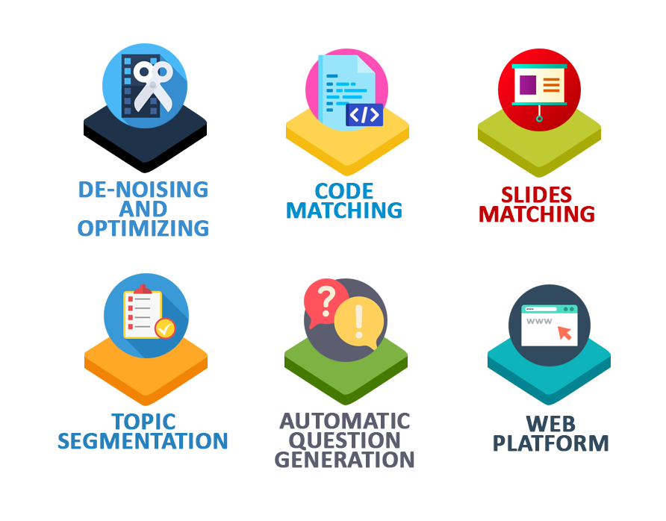
Core Modules of the Platform

Slide 7
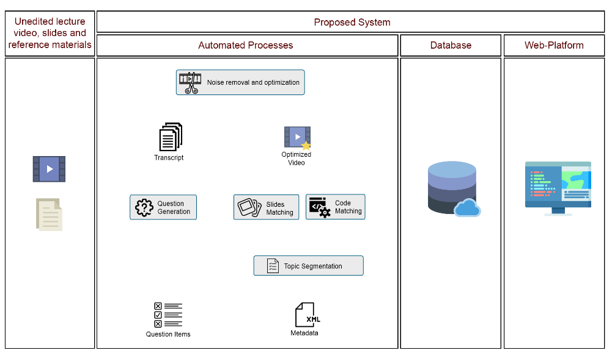
System Architecture

Slide 8






Source Code Matching
Frames Containing Code
Video Frames
Neural network
Extracted Audio
Line Matching Algorithm
<output>
<line/>
<timestamp/>
</output >
Source Code File

Slide 9
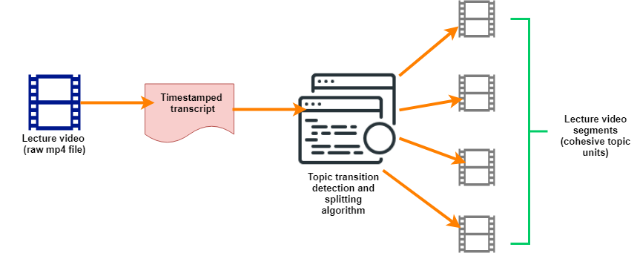
Topic Generation and Video Segmentation
Extracts timestamped transcripts.
Identifies topic transitions and segment the videos into cohesive topic units
Enables easier information searching and reduce learning time

Slide 10

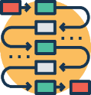


Automatic Question Generation
Transcript
Ontology
Extracted Sentences and Words
Question generation and distractor selection
Reference materials
Question Items

Slide 11
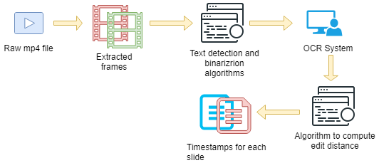
Synchronization of lecture video and slides

Slide 12
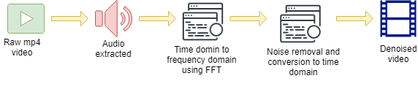
Noise Removal

Slide 13





Existing Systems
Notes:
We have done some reasearch and found out that there are platforms which are similar, but don’t provide the rich functionality that our platform does.

Slide 14
Feature Comparison
Features | echo360 | TechSmith Relay | Camtasia | LearnWorlds | Hippo Video | Proposed System
Automatically matching code samples to occurrence in recorded lecture | ✗ | ✗ | ✗ | ✗ | ✗ | ✔
Automatically divide video into topic units | ✗* | ✗ | ✗ | ✗ | ✗ | ✔
Automatically match lecture slides with the recorded video | ✗** | ✗** | ✗** | ✗ | ✗** | ✔
Automatic question generation | ✗ | ✗ | ✗ | ✗ | ✗ | ✔
* Only if integrated with LMS or with provided topics
** Only if recorded using their proprietary recording tools or editing tools
Notes:
As you can see from this table the other existing platforms do not have the functionality or only have them to a certain extent

Slide 15

Target users
Lecturers / content creators
Students

Slide 16
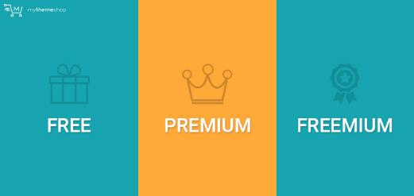

Business Potential
Potential Business Models
Plugin for several existing MOOCs and LMSs
Software as a Service (SaaS) product, where the customer will pay a one-time fee or monthly subscription or as a freemium model
advertisements can be incorporated into a web application.
Achievable user benefits
The system will fully automate otherwise tedious manual processes involved in creating lectures.
Enhanced online lectures which are tied in seamlessly with supporting content.
Notes:
Either way we will be able to monetize this application easily.
Now I'd like to walk you through the operation of the platform.

Slide 17
THANK YOU!

